Slide 1
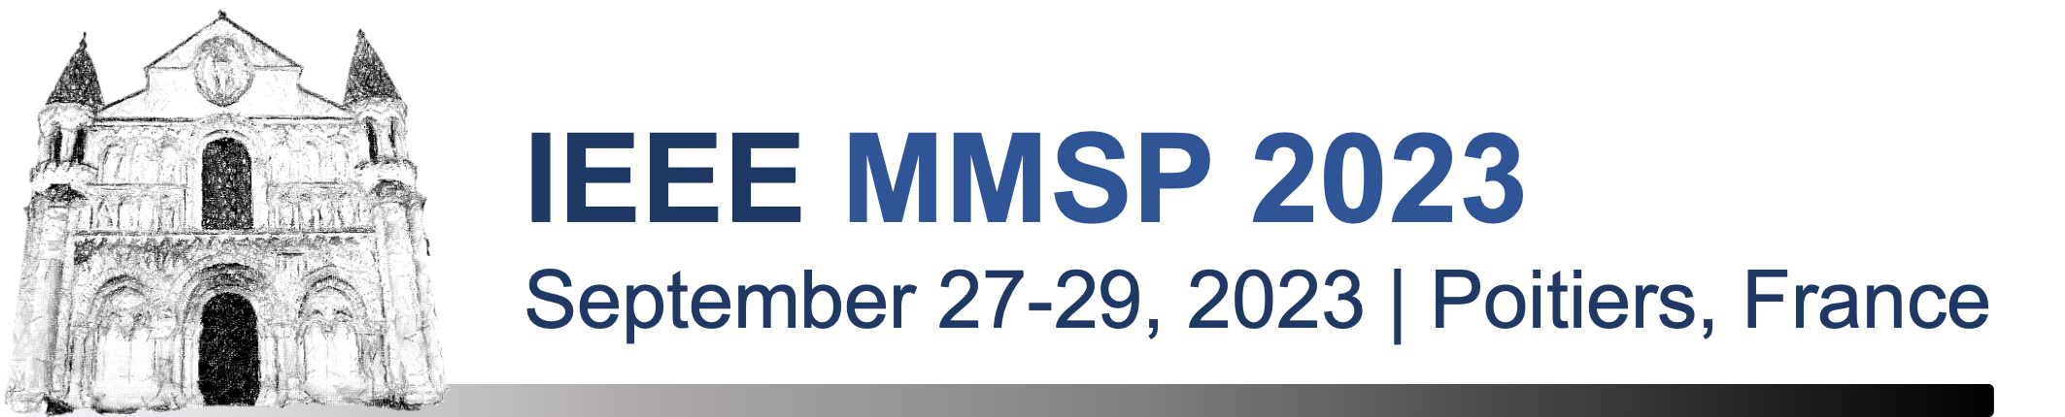

Comparison of metrics for predicting image and video quality at varying viewing distances
MMSP 2023
Quality Assessment and Enhancement for Multimedia Visual Signals (SS)
Dounia Hammou¹, Lukáš Krasula², Christos G. Bampis², Zhi Li², Rafał K. Mantiuk¹
¹ University of Cambridge, UK
² Netflix Inc., US

Slide 2

Quality Assessment Applications
Optimizing content delivery
Enhancing content Quality

Slide 3
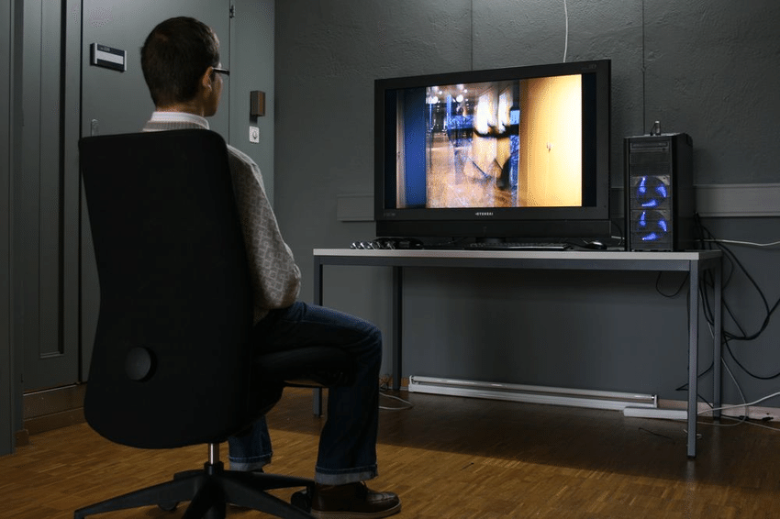
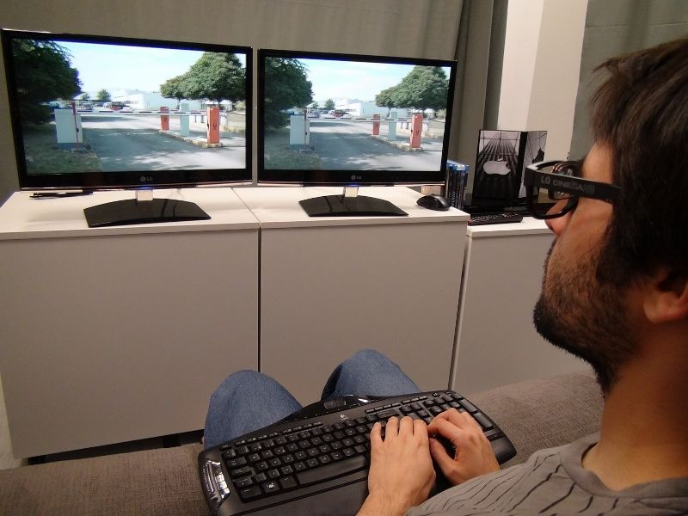
Display and Viewing Conditions
“Lab Environment”
Quality metrics are calibrated for one or few datasets.
Many of these datasets were collected in a lab environment with a fixed optimal viewing distance.

Slide 4

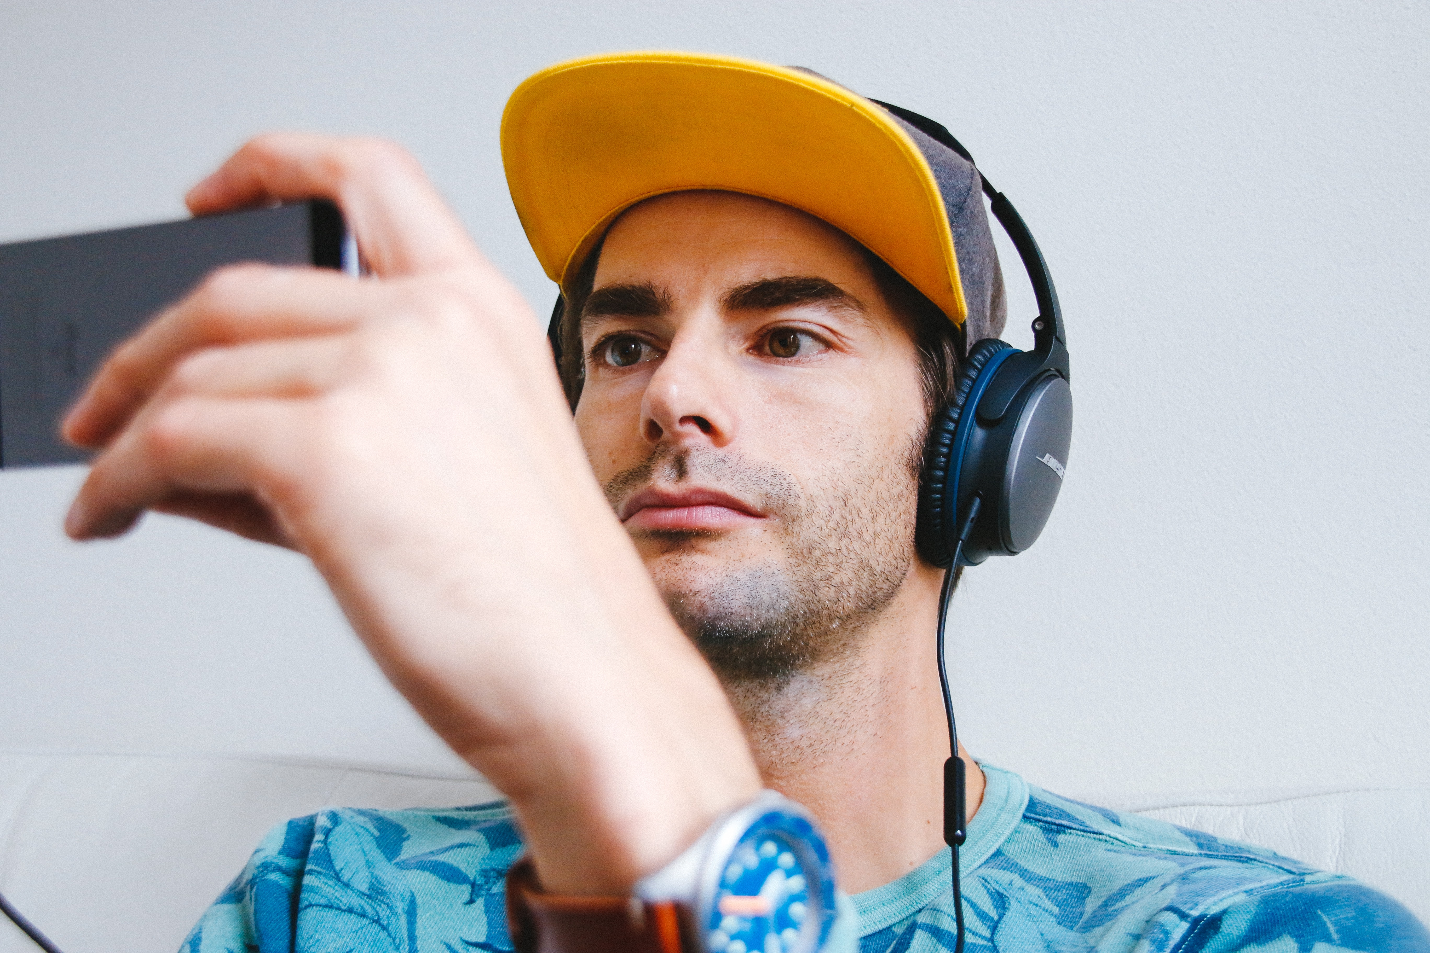


Display and Viewing Conditions
“Real-Life Environment”

Slide 5
02
The effect of viewing conditions on the perceptual quality

Slide 6

Effective Resolution
Viewing Distance

Slide 7
Effective Resolution
Viewing Distance

Slide 8
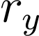
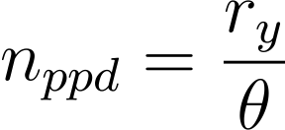
Effective Resolution
Vertical
Resolution
Viewing Distance
Effective Resolution [pixels per degree (ppd)]

Slide 9
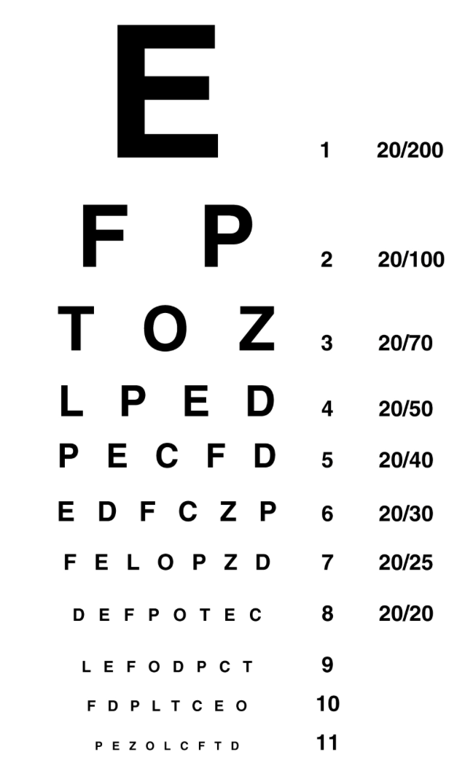
Effective Resolution and Perceptual Quality
The sensitivity to contrast decreases with the increase of effective resolution.

Slide 10
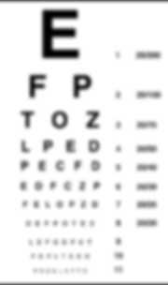
Effective Resolution and Perceptual Quality
The sensitivity to contrast decreases with the increase of effective resolution.

Slide 11
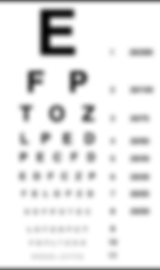
Effective Resolution and Perceptual Quality
The sensitivity to contrast decreases with the increase of effective resolution.

Slide 12
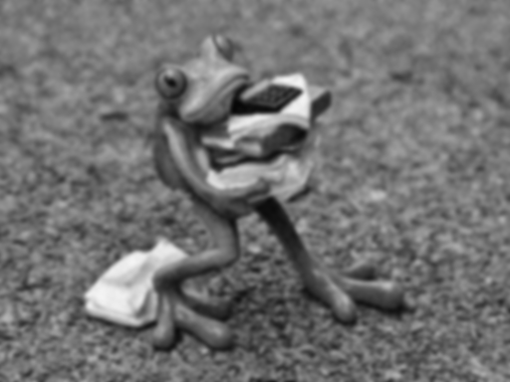


Effective Resolution and Perceptual Quality
90 ppd
60 ppd
30 ppd
The visibility of distortions decreases with the increase of effective resolution.

Slide 13
03
Quality assessment metrics for varying viewing distances

Slide 14
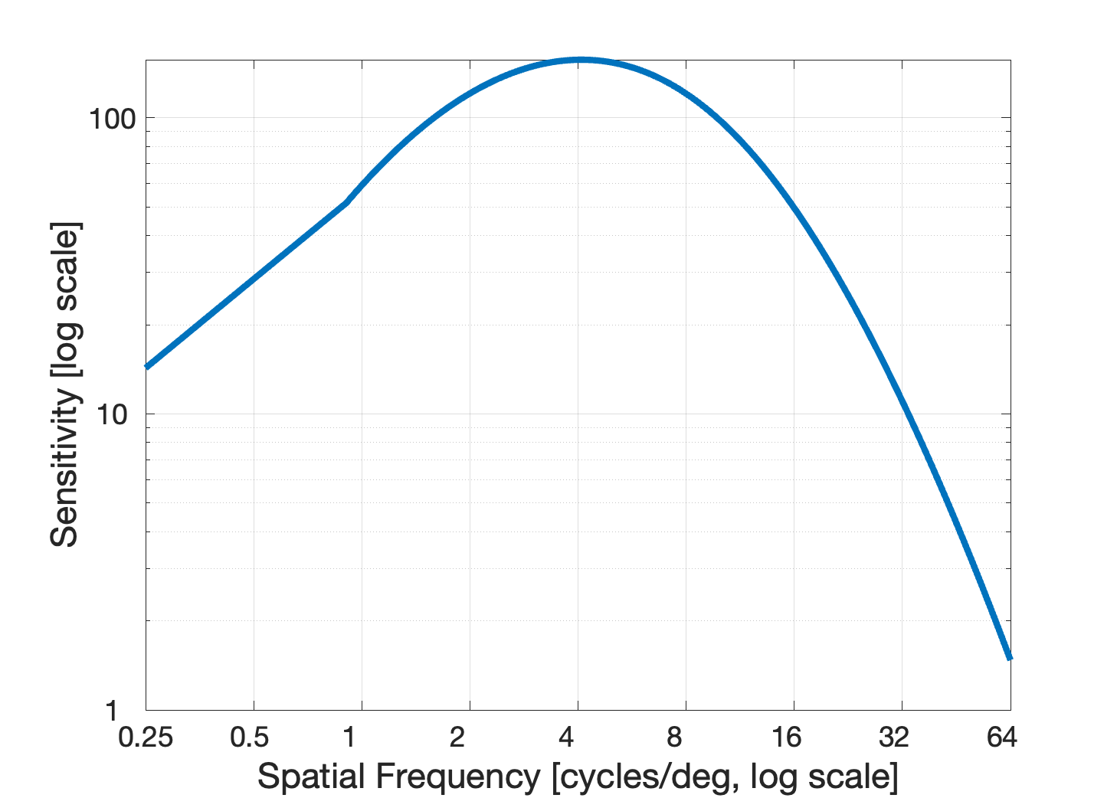
Contrast Sensitivity Function
The contrast sensitivity function (CSF) of the human visual system predicts the smallest contrast detectable by an average observer on a uniform background.

Slide 15
The applications of CSF in Quality Metrics
sCIELab
The contrast sensitivity function can be used to pre-filter the images in another color space such as the CIELAB space.
Zhang, X., & Wandell, B. A. (1997). A spatial extension of CIELAB for digital color‐image reproduction. Journal of the society for information display, 5(1), 61-63.

Slide 16
The applications of CSF in Quality Metrics
FovVideoVDP and HDR-VDP-3
The contrast sensitivity function can be used to weight each band of a band-pass decomposition by the corresponding sensitivity.
Mantiuk, R. K., Hammou, D., & Hanji, P. (2023). HDR-VDP-3: A multi-metric for predicting image differences, quality and contrast distortions in high dynamic range and regular content. arXiv preprint arXiv:2304.13625.
Mantiuk, R. K., Denes, G., Chapiro, A., Kaplanyan, A., Rufo, G., Bachy, R., ... & Patney, A. (2021). Fovvideovdp: A visible difference predictor for wide field-of-view video. ACM Transactions on Graphics (TOG), 40(4), 1-19.

Slide 17
Rescaling Function
Quality metrics can be adapted for varying viewing distances by rescaling the input images/videos.
This principle comes from the observation that doubling the viewing distance, halves the image/video resolution.
Effective Resolution

Slide 18
Rescaling Function
Quality metrics can be adapted for varying viewing distances by rescaling the input images/videos.
This principle comes from the observation that doubling the viewing distance, halves the image/video resolution.
Effective Resolution
Calibrated Resolution

Slide 19
Rescaling Function
Quality metrics can be adapted for varying viewing distances by rescaling the input images/videos.
This principle comes from the observation that doubling the viewing distance, halves the image/video resolution.
Calibrated Resolution

Slide 20
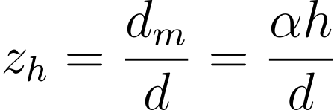
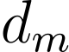

Rescaling Function
We can derive the rescaling factor as follows:
Where is the viewing distance for which the metric was calibrated for, and is the viewing distance of the image.
Effective Resolution
Calibrated Resolution

Slide 21
04
Comparison analysis
Comparison of CSF-based and rescaling-based metrics for the task of predicting quality across varying viewing distances.

Slide 22
Quality Metrics
CSF-based metrics
FR-Image metrics
FR-Video metrics
NR-Image metrics
sCIELab
FovVideoVDP
HDR-VDP-3
PSNR
SSIM
MS-SSIM
FSIM
GMSD
SFF
VIF
LPIPS
VMAF
SpEED-QA
BRISQUE
BIQI
NIQE
FRIQUEE
PIQE
HyperIQA

Slide 23
Quality Datasets
Dataset | Conditions (References) | Display Size [in] | Effective Resolution [ppd] | Viewing Distance as multiplies of display heights
VDID2014 [1] | 160 (8) | unknown | 38 57 | 2 3
CID:IQ [2] | 690 (23) | 24” | 32 64 | 1.7 3.3
VCIP21 [3] | 15 (5) | 46” | 60 92 129 | 3.2 4.9 6.8
VLIC [4] | 184 (20) | 27” | 32 61 | 1.2 2.4
[1] Gu, K., Liu, M., Zhai, G., Yang, X., & Zhang, W. (2015). Quality assessment considering viewing distance and image resolution. IEEE Transactions on Broadcasting, 61(3), 520-531.
[2] Liu, X., Pedersen, M., & Hardeberg, J. Y. (2014). CID: IQ–a new image quality database. In Image and Signal Processing: 6th International Conference, ICISP 2014, Cherbourg, France, June 30–July 2, 2014. Proceedings 6 (pp. 193-202). Springer International Publishing.
[3] Amirpour, H., Schatz, R., Timmerer, C., & Ghanbari, M. (2021, December). On the impact of viewing distance on perceived video quality. In 2021 International Conference on Visual Communications and Image Processing (VCIP) (pp. 1-5). IEEE.
[4] Mikhailiuk, A., Ye, N., & Mantiuk, R. K. (2021). The effect of display brightness and viewing distance: A dataset for visually lossless image compression.

Slide 24
Evaluation Protocol
Correlation Coefficients: SROCC, PLCC, KROCC
RMSE
However, such evaluation protocols do not account for the variance in the subjective data. Such variance can cause some of the performance differences between quality metrics.

Slide 25
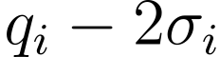
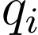
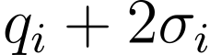
Parametric Resampling
Assuming each quality score follows a gaussian distribution. We can draw the subjective score values from the gaussian distribution.
Then we can compute the distribution of the performance indicator for each metric.

Slide 26
Performance Comparison
To test the statistical evidence of the results, we applied the one-tailed t-test at 0.05 significance level.
?

Slide 27
Metrics Evaluation

Slide 28
Metrics Evaluation

Slide 29
Metrics Evaluation

Slide 30
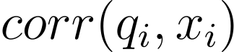
The effect of viewing distance disentangled
Ground truth
Metric’s prediction

Slide 31

The effect of viewing distance disentangled
Ground truth at viewing
distance j
Ground truth at viewing distance k

Slide 32
Metrics Evaluation (Disentangled data)

Slide 33
Metrics Evaluation (Disentangled data)

Slide 34
Metrics Evaluation (Disentangled data)

Slide 35
Conclusion
We investigated the performance of existing metrics on the task of predicting quality at different viewing distances.
There is no statistical evidence suggesting that one approach is better than the other.
Both approaches fail in the task.
We require more publicly available datasets that analyse this variable.
We require new metrics that are calibrated and trained on such datasets.

Slide 36

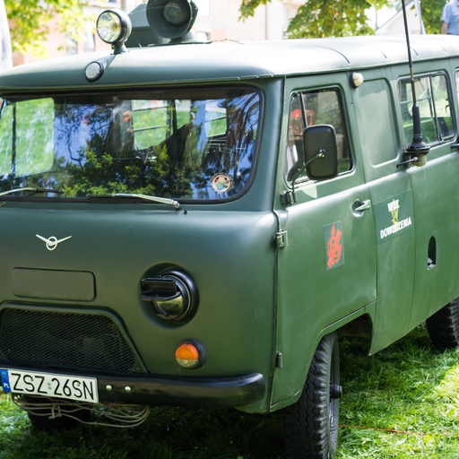

Thank you Any Question?
36

